Slide 2
Data types in Java
Data types specify the different sizes and values that can be stored in the variable. There are two types of data types in Java:
Primitive data types: The primitive data types include boolean, char, byte, short, int, long, float and double.
Non-primitive data types: The non-primitive data types include Classes, Interfaces, and Arrays.

Slide 3
Java Primitive Data Types
In Java language, primitive data types are the building blocks of data manipulation. These are the most basic data types available in Java language.
There are 8 types of primitive data types:
boolean data type
byte data type
char data type
short data type
int data type
long data type
float data type
double data type

Slide 4
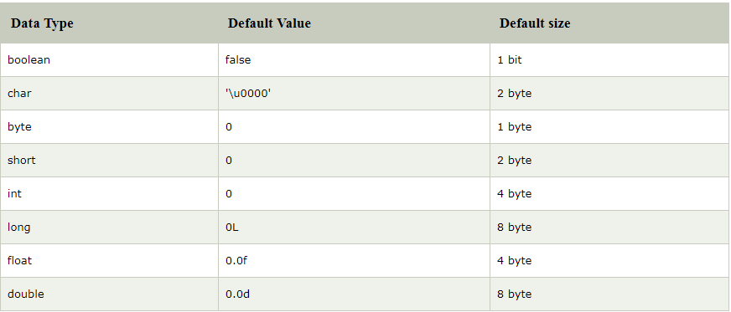

Slide 5
Why char uses 2 byte in java and what is \u0000 ?
It is because java uses Unicode system not ASCII code system. The \u0000 is the lowest range of Unicode system.

Slide 6
Unicode System
Unicode is a universal international standard character encoding that is capable of representing most of the world's written languages.
Before Unicode, there were many language standards:
ASCII (American Standard Code for Information Interchange) for the United States. ISO 8859-1 for Western European Language. KOI-8 for Russian. GB18030 and BIG-5 for chinese, and so on.
This caused two problems: 1. A particular code value corresponds to different letters in the various language standards. 2. The encodings for languages with large character sets have variable length.Some common characters are encoded as single bytes, other require two or more byte.
To solve these problems, a new language standard was developed i.e. Unicode System.
In unicode, character holds 2 byte, so java also uses 2 byte for characters.
lowest value:\u0000
highest value:\uFFFF

Slide 7
Type conversions
When you assign value of one data type to another, the two types might not be compatible with each other. If the data types are compatible, then Java will perform the conversion automatically known as Automatic Type Conversion and if not then they need to be casted or converted explicitly. For example, assigning an int value to a long variable.

Slide 8

Widening or Automatic Type Conversion
Widening conversion takes place when two data types are automatically converted. This happens when:
The two data types are compatible.
When we assign value of a smaller data type to a bigger data type.
For Example, in java the numeric data types are compatible with each other but no automatic conversion is supported from numeric type to char or boolean. Also, char and boolean are not compatible with each other.

Slide 9

Narrowing or Explicit Conversion
If we want to assign a value of larger data type to a smaller data type we perform explicit type casting or narrowing.
This is useful for incompatible data types where automatic conversion cannot be done.
Here, target-type specifies the desired type to convert the specified value to.

Slide 10
Type promotion in Expressions
While evaluating expressions, the intermediate value may exceed the range of operands and hence the expression value will be promoted. Some conditions for type promotion are:
Java automatically promotes each byte, short, or char operand to int when evaluating an expression.
If one operand is a long, float or double the whole expression is promoted to long, float or double respectively.

Slide 11
Examples
1. int g = 3;
System.out.print(++g * 8);
2. char a = 'A';
a++;
System.out.print((int)a);
3. boolean var1 = true;
boolean var2 = false;
System.out.println((var1 & var2));

Slide 12
Examples
4.
class Test
{
public static void main(String args[])
{
byte b = 42;
char c = 'a';
short s = 1024;
int i = 50000;
float f = 5.67f;
double d = .1234;
// The Expression
double result = (f * b) + (i / c) - (d * s);
//Result after all the promotions are done
System.out.println("result = " + result);
}
}

Slide 13
Operators
Operator in java is a symbol that is used to perform operations. For example: +, -, *, / etc.

Slide 14
There are many types of operators in java which are given below:
Unary Operator,
Arithmetic Operator,
Shift Operator,
Relational Operator,
Bitwise Operator,
Logical Operator,
Ternary Operator and
Assignment Operator.

Slide 15
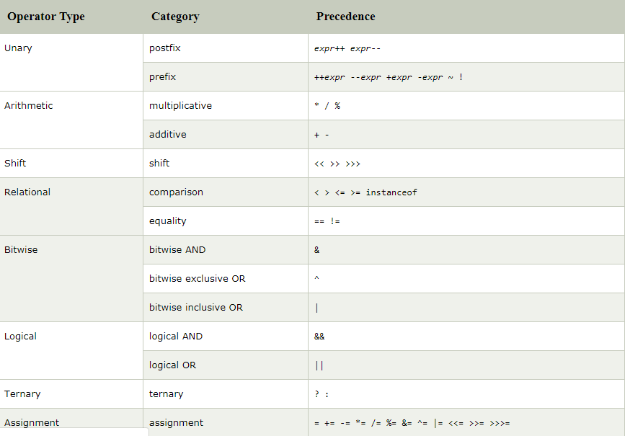

Slide 16
Example
Example 1
int a=10;
int b=10;
System.out.println(a++ + ++a);
System.out.println(b++ + b++);
Example 2
boolean c=true;
System.out.println(!c);

Slide 17
Example 3
System.out.println(10<<2);
System.out.println(10<<3);
System.out.println(20<<2);
System.out.println(15<<4);

Slide 18
Example 4
System.out.println(10>>2);
System.out.println(20>>2);
System.out.println(20>>3);

Slide 19
>> vs >>> Example 5
//For positive number, >> and >>> works same
System.out.println(20>>2);
System.out.println(20>>>2);
//For negative number, >>> changes parity bit (MSB) to 0
System.out.println(-20>>2);
System.out.println(-20>>>2);

Slide 20
Logical && and Bitwise &
You can guess bitwise operates at bit level and perform AND logical operation to each bit, while logical operators operate on boolean variables only. Main difference lies in there short circuit behavior, which means if there are two or more conditions, which are joined using && or || operator then not all conditions are tested as soon as you have enough data to determine result.
The logical && operator doesn't check second condition if first condition is false. It checks second condition only if first one is true.
The bitwise & operator always checks both conditions whether first condition is true or false.

Slide 21
Example 6
int a=10;
int b=5;
int c=20;
System.out.println(a<b&&a<c); System.out.println(a<b&a<c);

Slide 22
Java Assignment Operator Example 7
public static void main(String[] args){
int a=10;
a+=3;
System.out.println(a);
a-=4;
System.out.println(a);
a*=2;
System.out.println(a);
a/=2;
System.out.println(a);
}

Slide 23
Example 8(adding short)
public static void main(String args[]){
short a=10;
short b=10;
a=a+b;
System.out.println(a);
}

